Slide 1
EECE 528
Caches
Instructor: Prof. Guy lemieux
lemieux@ece.ubc.ca
(many slides courtesy of Prof. Tor Aamodt)

Slide 2
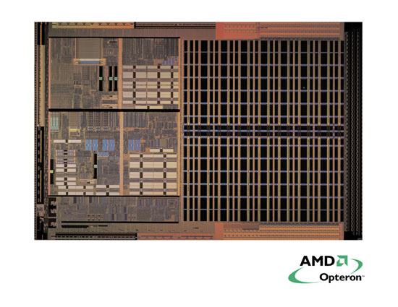
Importance of Cache Memory
Fast CPUs are Mostly Cache!
Total Area: 193 mm²
42% 1MB L2 Cache
4% Instr. Cache
4% Data Cache
(50% is cache)
13% HyperTransport
10% DDR Memory
(23% is I/O)
6% Fetch/Scan/etc
4% Mem Controller
4% FPU
3% Exec Units
2% Bus Unit
(only 20% is actually CPU!)
Floating-Point Unit
1 MB Unified
Instruction/Data
Level 2 Cache
Load/Store
64 kB
Data
Cache
Execution
Unit
Bus
Unit
Fetch Scan
Align
Micro-code
64 kB
Instr.
Cache
Memory Controller
HyperTransport
DDR Memory Interface

Slide 3
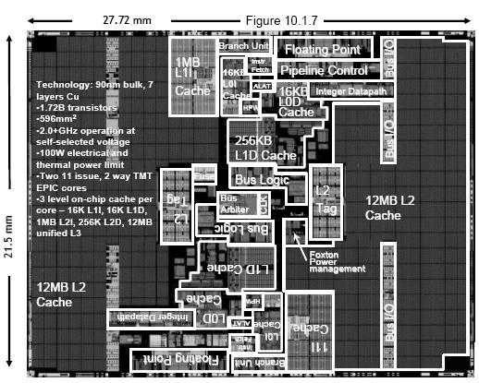
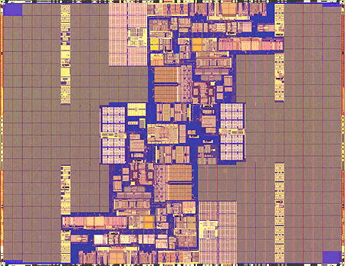
Intel Itanium CPU

Slide 4
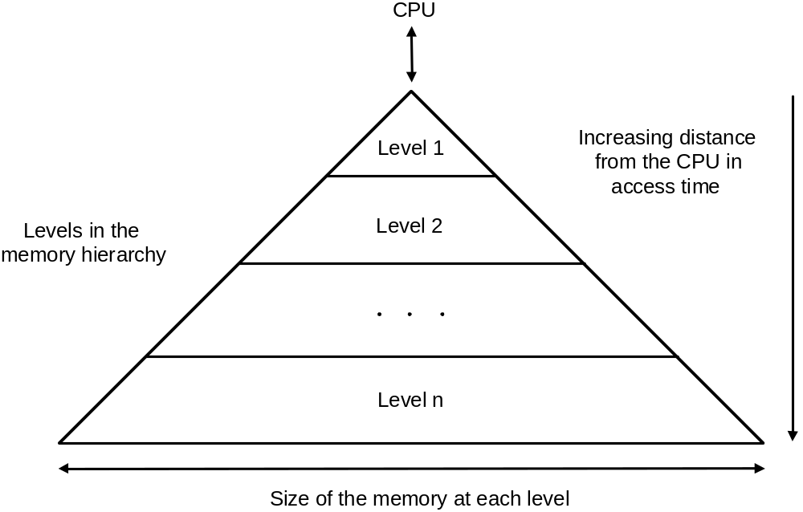
Memory Hierarchy
Multiple
Levels of
Memory

Slide 5
What is a cache?
Small, fast storage used to improve average access time to slow memory.
Exploits “spatial” and “temporal” “locality”
Many forms of cache:
  Registers are a “software managed” cache on variables
  First-level cache is a cache on second-level cache
  Second-level cache is a cache on memory
  Memory is a cache on disk (virtual memory—see next slide set)
  TLB a cache on page table (see next slide set)
  Branch-prediction a cache on prediction information
Regs
Faster
L1-Cache
L2-Cache
Memory
Bigger
Disk, Tape, etc.

Slide 6
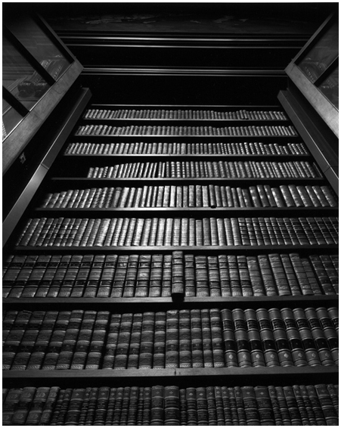


How does a cache work?
Analogy:
Cache => Is book I want in backpack?
DRAM => Is book in UBC library?
Disk => inter-library loan
Temporal Locality (analogy):
If I use book once, likely to
use it again soon.
Spatial Locality (analogy):
If last time you went to library
you took out a book
from section XYZ (e.g.,
“mystery novels”), more likely to
go to section XYZ next time you
return to library.
Smaller => faster!

Slide 7
The Memory Wall
CPU-DRAM Gap
1980: no cache in µproc; 1995 2-level cache on chip
(1989 first Intel µproc with a cache on chip)
1000
µProc
60%/yr.
CPU
“Moore’s Law”
100
Processor-Memory
Performance Gap:
(grows 50% / year)
Performance
10
DRAM
7%/yr.
DRAM
1
1989
1980
1990
1981
1982
1983
1984
1985
1986
1987
1988
1991
1992
1993
1994
1995
1996
1997
1998
1999
2000
Notes:
Y-axis is performance
X-axis is time
Latency
Cliché:
Not e that x86 didn’t have cache on chip until 1989

Slide 8
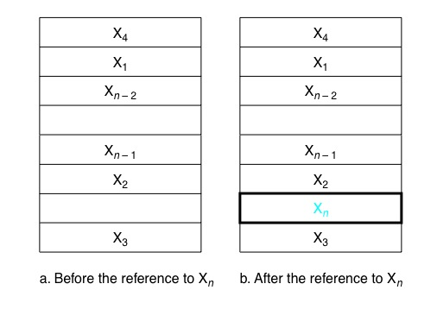
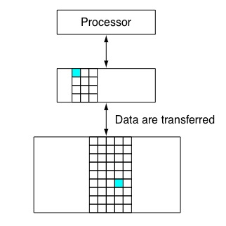
Cache Basics
X_{n}
Contents of cache, before and after reference to a word X_{n}
After reference X_{n}, keep local copy in case we need to access it again.
NOTE: Hardware automatically manages contents of cache

Slide 9
Cache Blocks (Cache Lines)
Loads and stores typically access 4 bytes or 8 bytes.
However, to help exploit spatial locality, caches are organized around a larger, contiguous region of memory called a “block” (or “line”)
Typical sizes for a “cache block” (“cache line”) are
16 bytes, 32 bytes, 64 bytes, 128 bytes, 256 bytes.
Caches usually implemented using SRAM (bigger / more costly than DRAM)

Slide 10
Cache Blocks Contain Multiple Bytes
Example: Block size 16B (16 bytes)
data accessed
by single load
Block 0:
0x00 | 0x01 | 0x02 | 0x03 | 0x04 | 0x05 | 0x06 | 0x07 | 0x08 | 0x09 | 0x0A | 0x0B | 0x0C | 0x0D | 0x0E | 0x0F
0x10 | 0x11 | 0x12 | 0x13 | 0x14 | 0x15 | 0x16 | 0x17 | 0x18 | 0x19 | 0x1A | 0x1B | 0x1C | 0x1D | 0x0E | 0x1F
0x20 | 0x21 | 0x22 | 0x23 | 0x24 | 0x25 | 0x26 | 0x27 | 0x28 | 0x29 | 0x2A | 0x2B | 0x2C | 0x2D | 0x2E | 0x2F
0x30 | 0x31 | 0x32 | 0x33 | 0x34 | 0x35 | 0x36 | 0x37 | 0x38 | 0x39 | 0x3A | 0x3B | 0x3C | 0x3D | 0x3E | 0x3F
Block 1:
Block 2:
Block 3:
Numbers inside squares are byte address of memory location
represented by square—not the actual contents of the block.
Block starts at an integer multiple of block size (aligned
with respect to block size)

Slide 11
Traditional Four Questions for Memory Hierarchy Designers
Q1: Where can a block be placed in the cache? ___ (Block placement)
  ___Fully Associative, Set Associative, Direct Mapped
Q2: How is a block found if it is in the cache?
___(Block identification)
  ___Tag/Index, Combination
Q3: Which block should be replaced on a miss?
___ (Block replacement)
  ___Random, LRU, …
Q4: What happens on a write?
___ (Write strategy)
  ___Write Back or Write Through (with Write Buffer)

Slide 12
Q1: Where to put block
The cache hardware can be simplified if we restrict where a block can be placed.
The simplest scheme restricts us to place a given block in a single location. This is known as a “direct mapped” cache.

Slide 13
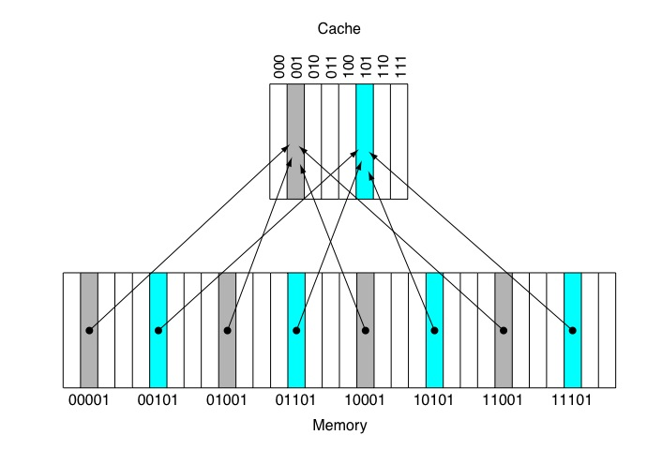
Q1: Direct Mapped Cache
Index = (Block Address) modulo (Number of cache blocks)
NOTE: Multiple addresses
have the same index.
Hardware “hash table”
Need way to distinguish
different blocks in cache.

Slide 14

Block Placement and Identification
Divide address into three parts: Tag, index, block offset
Most Significant Bits
Least Significant Bits
Full memory address of object in memory
(typically 32- or 64-bits, object = byte address)
Use tag to
differentiate
blocks with
same index
Block Address
Block offset: To exploit spatial locality, cache block typically contains more than one byte. Often 32 or 64 bytes (thus 5 or 6 bits used for “block offset”).
NOTE: “Cache block” sometimes referred to as “cache line”

Slide 15
Q2: Finding A Block
If many blocks can be at the same location in the cache, we need a way to be sure the data in the cache is the one we are looking for.
This is accomplished using “tags”.
Each “cache block” has an associated “tag” that keeps enough bits of the address of the cache block to be able to distinguish different blocks that can be placed in the same location.

Slide 16
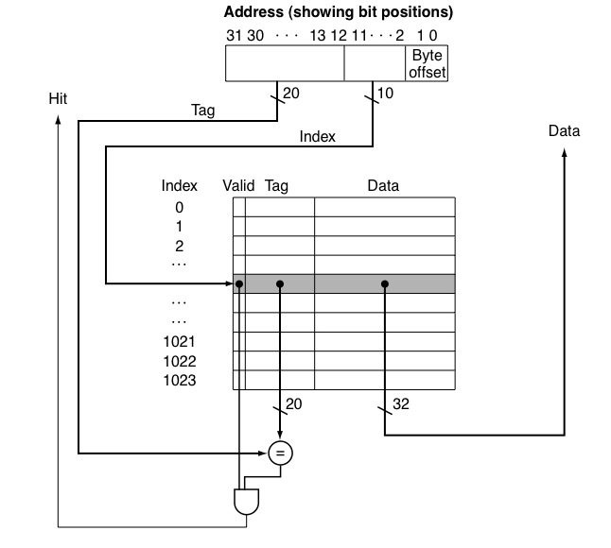
Implementation (Direct Mapped Cache)
Access begins with address indicating memory location.
Cache organized in two parts “tag array” and “data array”. (Shown joined in figure.)
Use “index” to select row, check if “valid”, and if “tag” matches upper address bits of address. If both “yes”, then we have a “cache hit”, otherwise we have a “cache miss”.
If “cache hit”, use block offset (byte offset) to select bytes in block to read/write.

Slide 17
Q1: Block Placement, Revisited
The “direct mapped” cache organization is simple (and fast), but can lead to poor performance if two or more cache blocks that are frequently accessed happen to “map” to the same location.
This turns out to be a problem encountered by real programs. To solve it, we need to give our cache more flexibility in where blocks can be placed.
This is typically done by making our caches “associative” (see next slide).

Slide 18
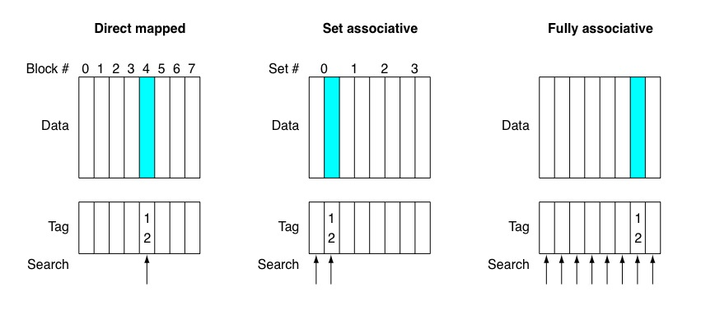
More flexible block placement
Direct Mapped (typically: fastest access time but lowest hit rate)
Index = (Block Address) MOD (Number of Cache Blocks)
Set associative (typically: used to balance tradeoff between access time and hit rate)
Index = (Block Address) MOD (Number of Sets in Cache)
Fully associative (typically: slowest access time but highest hit rate)
No index... can put block anywhere

Slide 19
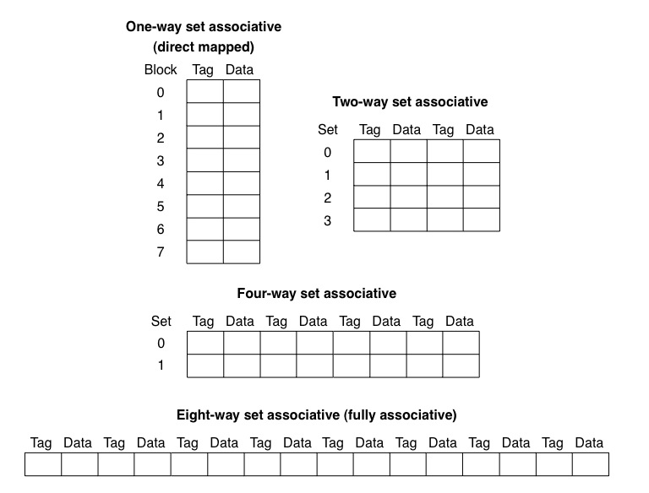
Set Associative Cache

Slide 20
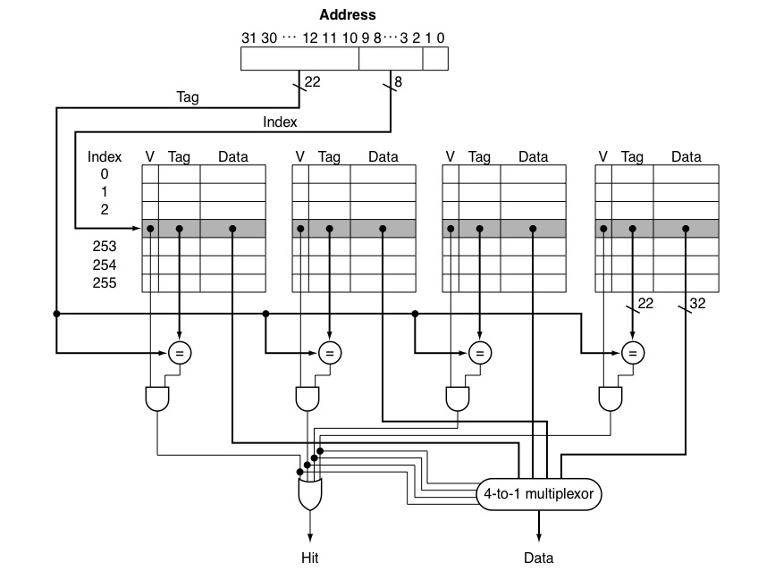
Implementation (Set associative cache)
Picture shows: “4KB, 4-way set associative cache with 4-byte blocks.”
Each “way” searched in parallel using “set index” (labeled Index in figure).
Select way that has matching tag (and valid bit).
If no match, have to bring from next level, and choose block to “evict” (Q3) to make space.

Slide 21
Q3: Which block should be replaced on a miss?
Since an associative cache allows multiple blocks to be in a set, we have a choice when a new block needs to be added to the cache (due to a cache miss).
Ideally, we would like to avoid replacing any block that will be referenced again before some other block already in the set.
Hence, we need to make a prediction about which block is least likely to be accessed again soon.

Slide 22
Q3: Replacement Policy (associative caches)
Least Recently Used (LRU) - evict the LRU block
Random - select which block to evict randomly
First-In First-Out (FIFO) - evict oldest first
 | Associativity
 | Two-way |  |  | Four-way |  |  | Eight-way
Size | LRU | Rand | FIFO | LRU | Rand | FIFO | LRU | Rand | FIFO
16KB | 114.1 | 117.3 | 115.5 | 111.7 | 115.1 | 113.3 | 109.0 | 111.8 | 110.4
64KB | 103.4 | 104.3 | 103.9 | 102.4 | 102.4 | 103.1 | 99.7 | 100.5 | 100.3
256KB | 92.2 | 92.1 | 92.5 | 92.1 | 92.1 | 92.5 | 92.1 | 92.1 | 92.5
Data cache misses per 1000 instructions (10 programs from SPEC 2000)

Slide 23
Example Problem
Consider the following series of memory references (byte addresses, in decimal): 2, 3, 2, 8, 10, and 2.
Assume a direct-mapped cache with 8 one-byte blocks that are initially empty.
  Label each reference in the list as a hit or a miss.
  Show the final contents of the cache.
Repeat the analysis with a two-way set associative cache with 2-byte blocks and total size of 16 bytes.

Slide 24
Solution
2 m, 3 m, 2 h, 8 m, 10 m, 2 m
2 m, 3 h, 2 h, 8 m, 10 m, 2 h
Cache set | Address
000
001
010
011
100
101
110
111
8
Cache Set | Address
00 | { - , - }
01 | { - , - }
10 | { - , - }
11 | { - , - }
10
[8,9]
2
2
2
3
[2,3]
[10,11]
[2,3]
[2,3]
Direct-mapped cache 2-way set associative
1 byte blocks 2 byte blocks
8 bytes total 16 bytes total

Slide 25
The 3 C’s
Cold Start Misses
  First time we access block of data, we have a miss => can’t avoid this by making cache bigger or changing associativity.
Capacity Misses
  Difference in cache misses suffered by a fully associative cache (typically assume LRU replacement) and an infinite size cache
Conflict Misses
  Difference in cache misses suffered in cache being analyzed (associative or direct mapped cache) and a fully associative cache with same capacity and block size. (So, fully associative has no conflict misses.)
NOTE: Typically, one does not actually try to decide whether a specific cache miss is a conflict or capacity miss (just measure total number of capacity and/or conflict misses). One reason: it is possible for miss rate fully assoc. > miss rate direct mapped.

Slide 26
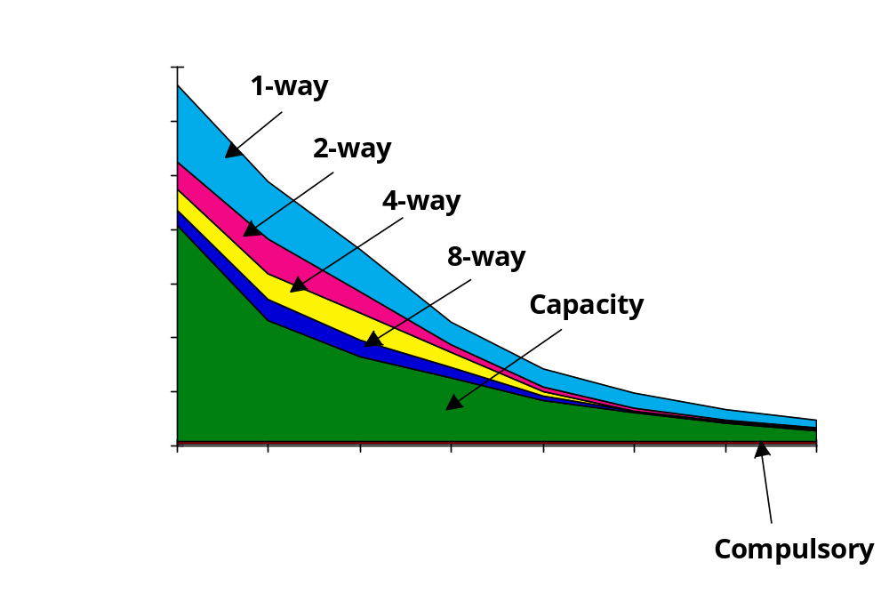
3Cs Absolute Miss Rate (SPEC92)
Conflict
Miss Rate
Cache Size

Slide 27
Impact of Cache Size
Miss Rate
Cache Size
Factor by which miss rate decreases is less than increase in cache size (here double cache size 2KB to 4KB, reduce miss rate ~ 20%);

Slide 28
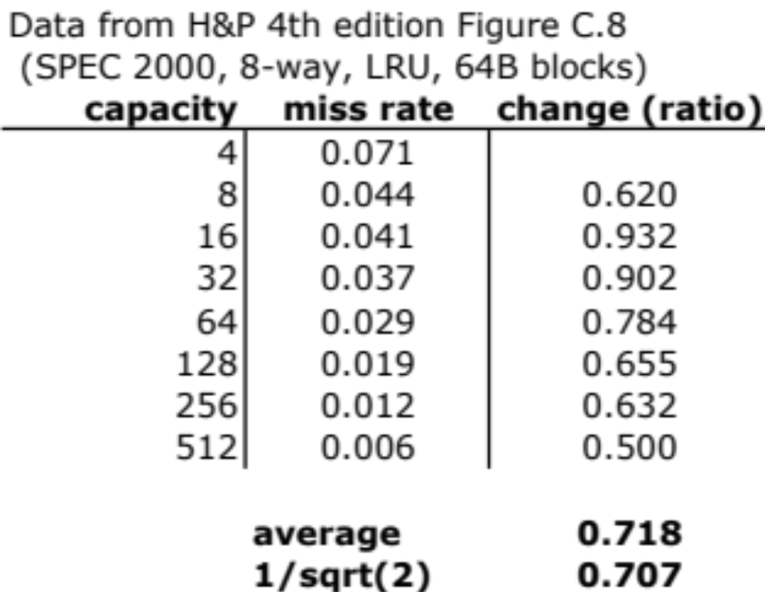
Increase in capacity
Old “rule of thumb” (very approximate, as data above shows)
factor by which miss rate decreases ∝ 1/sqrt(increase in capacity)

Slide 29
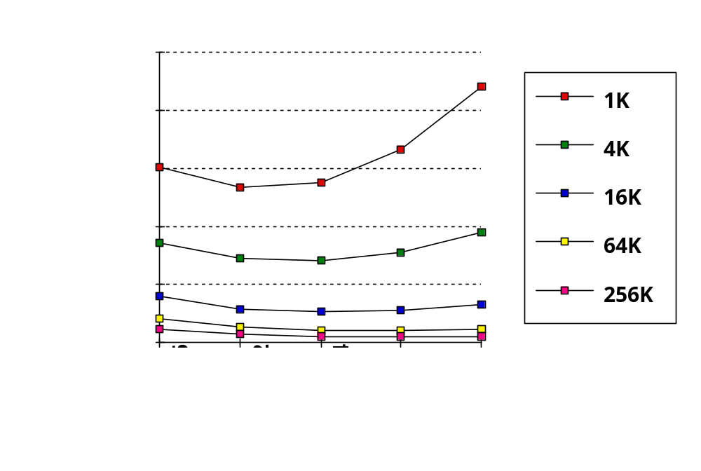
Larger Block Size (fixed size & assoc)
Miss Rate
Reduced
compulsory
misses
Block Size
Increased
Conflict
Misses
Also: Increase in block size may increase miss penalty.

Slide 30
Associativity
Conflict
Miss Rate
Cache Size
“2:1 cache rule of thumb” : miss rate of direct mapped
cache of size N is about same as 2-way of size N/2

Slide 31
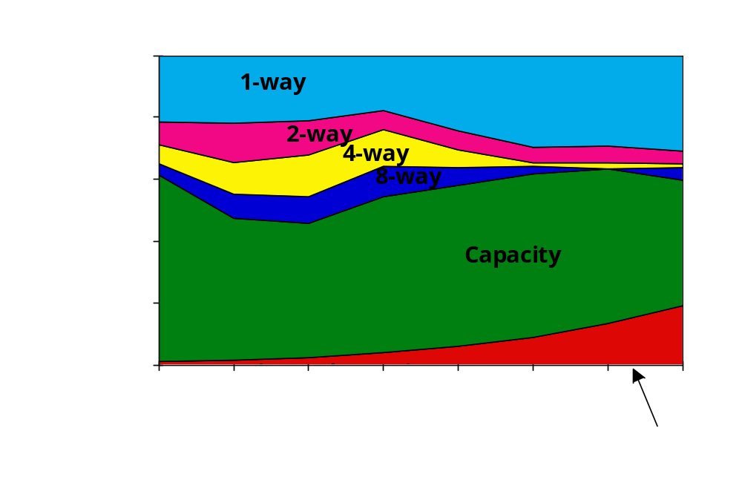
3Cs Relative Miss Rate
Fraction
Of All
Misses
Cache Size
Flaws: for fixed block size, replacement policy
Good: insight => invention
Conflict

Slide 32
Q4: What happens on a write? Cache Writing Policies
Write-through
  Store to both cache and memory on every write
    Slow writes
  Conservative: memory always holds valid data
  Simple cache
Write-back
  Store to cache only
    Fast writes
  On write, mark data block in cache as dirty
    Need extra memory bit for each cache line (dirty bit)
  Memory may hold invalid/stale data (must fix!)
  More complex cache

Slide 33
Q4: What happens on a write?
 | Write-Through | Write-Back
Policy | Data written to cache block also written to lower-level memory | Write data only to the cache Update lower level when a block falls out of the cache
Debug | Easy | Hard
Do read misses produce writes? | No | Yes
Do repeated writes make it to lower level? | Yes | No

Slide 34
Write Misses
(how are they handled by hardware?)
Writes can miss in cache… leads to a design choice (the design choice options are answers to question “how do we deal with write miss”). Two choices are:
  Write-allocate
    First, read cache block from memory into cache
    Second, proceed with write
  No write-allocate
    Write to memory directly
    Memory access is slow, CPU must wait
    Improve performance using “write buffers” (see later)
Most common design choices:
  Writeback cache uses write-allocate
  Write-through cache uses no write-allocate (keep it simple)

Slide 35
Counter-Intuitive Case 1:
Load instruction may cause Writes
Write-back cache problems
  Over time, many cache blocks marked “dirty”
  Eventually, must write dirty data back to memory
    Usually, when cache block is evicted
    (Also, if cache is “flushed” for OS context switch)
  Called a “writeback” event
Load may cause writes
  Load instruction miss, may evict a dirty cache block
    Write first: (old) dirty cache block writes to memory
    Read second: (new) memory block loaded into cache
  …but CPU is waiting for read result to do Load…
    Many CPUs do the “read first”
    Holds dirty cache block in special “write buffer” during read

Slide 36
Counter-Intuitive Case 2:
Store instruction may cause Reads
Writes can miss in the cache!
Store may cause Reads
  Writeback cache with write-allocate policy
    Store misses in cache
    CPU performs READ from memory, puts data in cache
    CPU performs write in cache, marks block dirty
It can be even more complex
  When store misses in cache above
    Must evict existing cache block
    If marked dirty, must first write back the cache block to memory
  CPU performs read from memory
  CPU performs write in cache

Slide 37
Write Buffers for Write-Through Caches
Cache
Lower Level Memory
Processor
Write Buffer
Holds data awaiting write-through to
lower level memory
Q. Why a write buffer ?
A. So CPU doesn’t stall
Q. Why a buffer, why not just one register ?
A. Bursts of writes are
common.
Q. Are Read After Write (RAW) hazards an issue for write buffer?
A. Yes! Drain buffer before next read, or send read after 1st checking write buffers.

Slide 38
5 Basic Cache Optimizations
Reducing Miss Rate
  Larger Block size (compulsory misses)
  Larger Cache size (capacity misses)
  Higher Associativity (conflict misses)
Reducing Miss Penalty
  4. Multilevel Caches
Reducing hit time
  Giving Reads Priority over Writes
    E.g., Read complete before earlier writes in write buffer

Slide 39
Multiple Cache Levels
Bigger Cache is slow
Instead, use multiple levels of caches
  L1 cache: (level 1 cache) smallest, fastest, in CPU datapath (eg, 8-64kB)
  L2 cache: usually on-chip with CPU, bigger (eg, 64kB-1MB)
  L3 cache: on-chip with CPU (eg >1MB), or off-chip (eg, >16MB!)
Split Cache
  Separate Instruction and Data Caches
  Used in L1 cache, tightly coupled to datapath of CPU
  Necessary for bandwidth: need to read instruction and data every cycle (I.e., prevent structural hazards)
Unified (I + D) Cache
  Slightly more effective than separate
    Avoids sizing problem of determining best proportion between I-cache and D-cache
  Used for L2, L3, etc caches

